Slide 1

Week 2
JINGYA LI

Slide 2


1
Academic Reading Skills
2
Group Presentation
CONTENTS
3
Exercises
4
Next session

Slide 3
Academic Reading Skills
Predicting theme and identifying patterns and structures

Slide 4
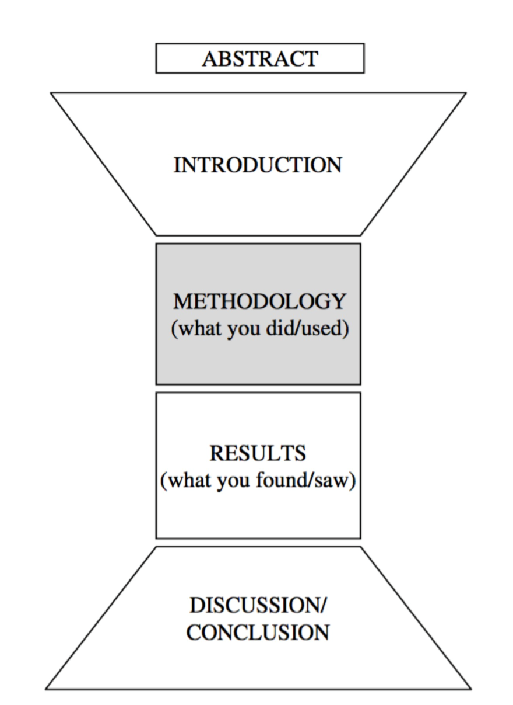
General structure of the research essay
Introduction
Literature review
Methodology
Results
Discussion/summary
Conclusion/general summary
Notes:
Group work

Slide 5
Where are you?

Slide 6
1. Chronological sequence
Writing in the order of time
Patterns:
time markers
In the form of adverbial clauses
Usually at the beginning or end of the sentence
Underline time markers of the paragraph on page 9

Slide 7
2. Cause and effect
Self-explanation
Deductive sequence
Inductive sequence
Aristotelian thought:
Conclusion/topic sentence/effect + evidence/rationale/cause/subordinary information
Identify the following paragraph: which is the effect and which is the cause

Slide 8
3. Comparison and contrast
Hypotactic language
Patterns: transitional devices/expressions
In addition, therefore, in contrast, etc.

Slide 9
4. Classification
Defining which category of information belongs to
Usually according to the nature or purpose of the content
Identifying types of analysis
quantitative or qualitative
Prescriptive or descriptive
Instructive or argumentative
Read 1st paragraph on page 11
What are the responses to the experience of emotion?
What does one’s emotional approach include?

Slide 10
5. Problem and solution
Problems identified and explained first
Potential solutions proposed later
Read the italic paragraph under Problem & Solution section
What is the problem?
What are the potential solutions?

Slide 11
Task 1
D

Slide 12
Task 2
C
H
L
D
A
B
F
I
J
E
K
G

Slide 13
Ultimatum Game vs. Dictator Game
Each group has two pairs
If you have three in a group, choose 1 as judge
Select a proposer and a respondent
The proposer will have $100, and needs to share it with you partner

Slide 14
Ultimatum Game vs. Dictator Game
Game 1: UG
the proposer needs to split $100 with the respondent, if the respondent accepts the offer, both players are rewarded using the proposed split.
If the respondent rejects the offer, then neither player is rewarded.
Game 2: DG
The respondent has no chance to reject the offer and all of the proposer’s offers are “accepted”
The proposer split the money first, write down the distributions
I will notify which pair plays which game.

Slide 15
Ultimatum Game vs. Dictator Game
Who has higher distributions?
Which game are you playing?
What is your role? A proposer or a respondent?
Which pair shares equal distributions?
Why choose equal distributions?
Being generous?
Anticipating refusal of inequitable distribution in UG?

Slide 16
Task 4
C
A
B

Slide 17
Next session
No group presentation
Academic Writing Skills
Unit 1 quiz: 15-20 mins

